Slide 1

Mental Health Town Hall
Facilitator Training

Slide 2
Introduction
Keep it short and sweet!
First Name and Affiliation
“I am here to help facilitate conversation, however I am NOT an expert…”
Notes:
And keep in mind…

Slide 3
Script
Follow it!
Let the group speak
Guide when guidance is needed
Notes:
And keep in mind…

Slide 4
Script
Wow! Those young women had a powerful message. We are here now to reflect on what we just heard and figure out what comes next. Why is this important? What can we do about it? But, before we get started, let’s talk about some community guidelines.
Notes:
And keep in mind…

Slide 5
Script
Acknowledge
  Acknowledge that the members of this group all have individual experiences that are their own and do not represent a group they may belong to.
  Acknowledge that this topic can be uncomfortable, and it is OK to feel discomfort.
Notes:
And keep in mind…

Slide 6
Script
Use “I” Statements
  Your feelings are your own.
  Use “I” statements to acknowledge that you are the person who has this feeling.
  Using “you” statements can feel accusatory to others.
Notes:
And keep in mind…

Slide 7
Script
Respect
  Be respectful to those speaking and those listening.
Trust
  Trust that the other people in this room are here to learn more and do more.
Listen
  You can learn a lot just taking a minute to listen to others before reacting.
Notes:
And keep in mind…

Slide 8
Script
Share the Mic
  We want all voices to be heard here and want everyone to have the same opportunity to speak.
  I may call on those who have not had an opportunity to speak, but please do not feel like you must speak.
Notes:
And keep in mind…

Slide 9
Script
Confidentiality
  What’s said here, stays here; what’s learned here, leaves here
No Experts
  None of us, including me, is an expert on this topic.
  We are here to have a respectful conversation about what was said during the panel discussion.
Notes:
And keep in mind…

Slide 10
Script
Now that we’ve set some community boundaries, let’s start by discussing how we were impacted by the panelists.
  As they were speaking, what stuck out to you most?
  What resonated with you?
Notes:
And keep in mind…

Slide 11
Script
Give the group time to speak. As conversation dies down, move on to the next set of questions.
    This is important! Give them time to actually speak!
Notes:
And keep in mind…

Slide 12
Script
Thank you for sharing; those are all good insights. The next step of the conversation is figuring out how to take this information and push forward. Ask yourself, “what now?”
  Thinking about how things have been in the past and what these young women have shared today, along with your own personal experience, what can YOU do to make a better future?
  How can YOU be a part of making it a reality?
  What do you think you can take from their examples to build YOUR OWN work?
  Remember, change can happen in both small ways and big ways!
Notes:
And keep in mind…

Slide 13
Script
Give the group time to speak. As conversation dies down, move on to challenge them and close out.
    Again, this is important! Give them time to actually speak!
Notes:
And keep in mind…

Slide 14
Script
Thank you all for being brave in this space today and speaking truth to power. I challenge you to take the things we just discussed and push forward to make the world a better place. Let’s wrap up by watching this short video.
Notes:
And keep in mind…

Slide 15
Wrap Up
Watch the video
Thank them for brave conversations
Make sure they know they can leave the Zoom at that point
Notes:
And keep in mind…

Slide 16
Script
Thank you all for being brave in this space today and speaking truth to power. I challenge you to take the things we just discussed and push forward to make the world a better place. Let’s wrap up by watching this short video.
Notes:
And keep in mind…

Slide 17
Zoom Specifics
Notes:
Please use Georgia Font for all text, copy and bullets.

Slide 18
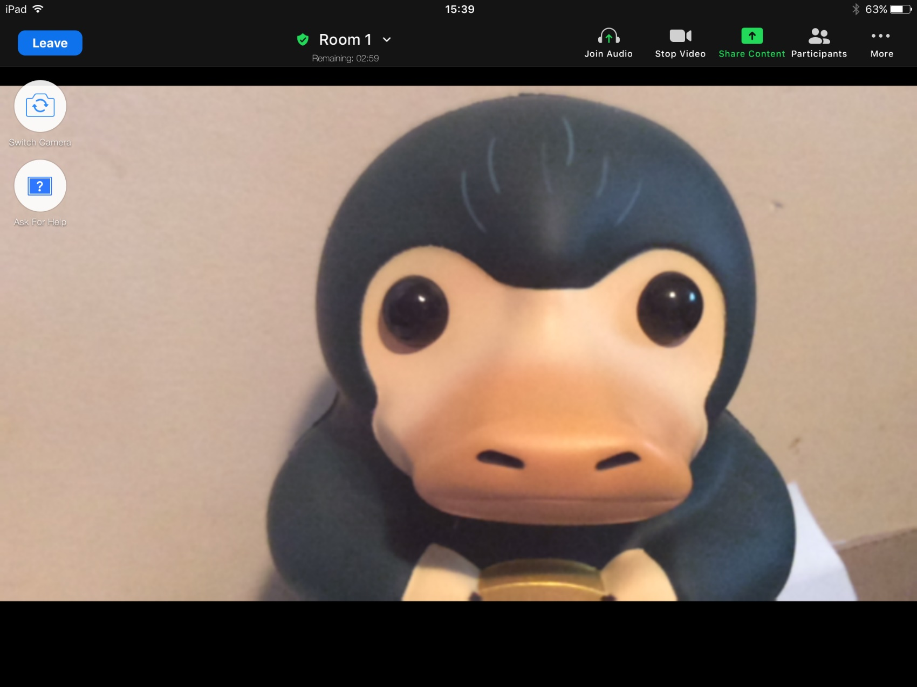
Help Button
Notes:
And keep in mind…

Slide 19
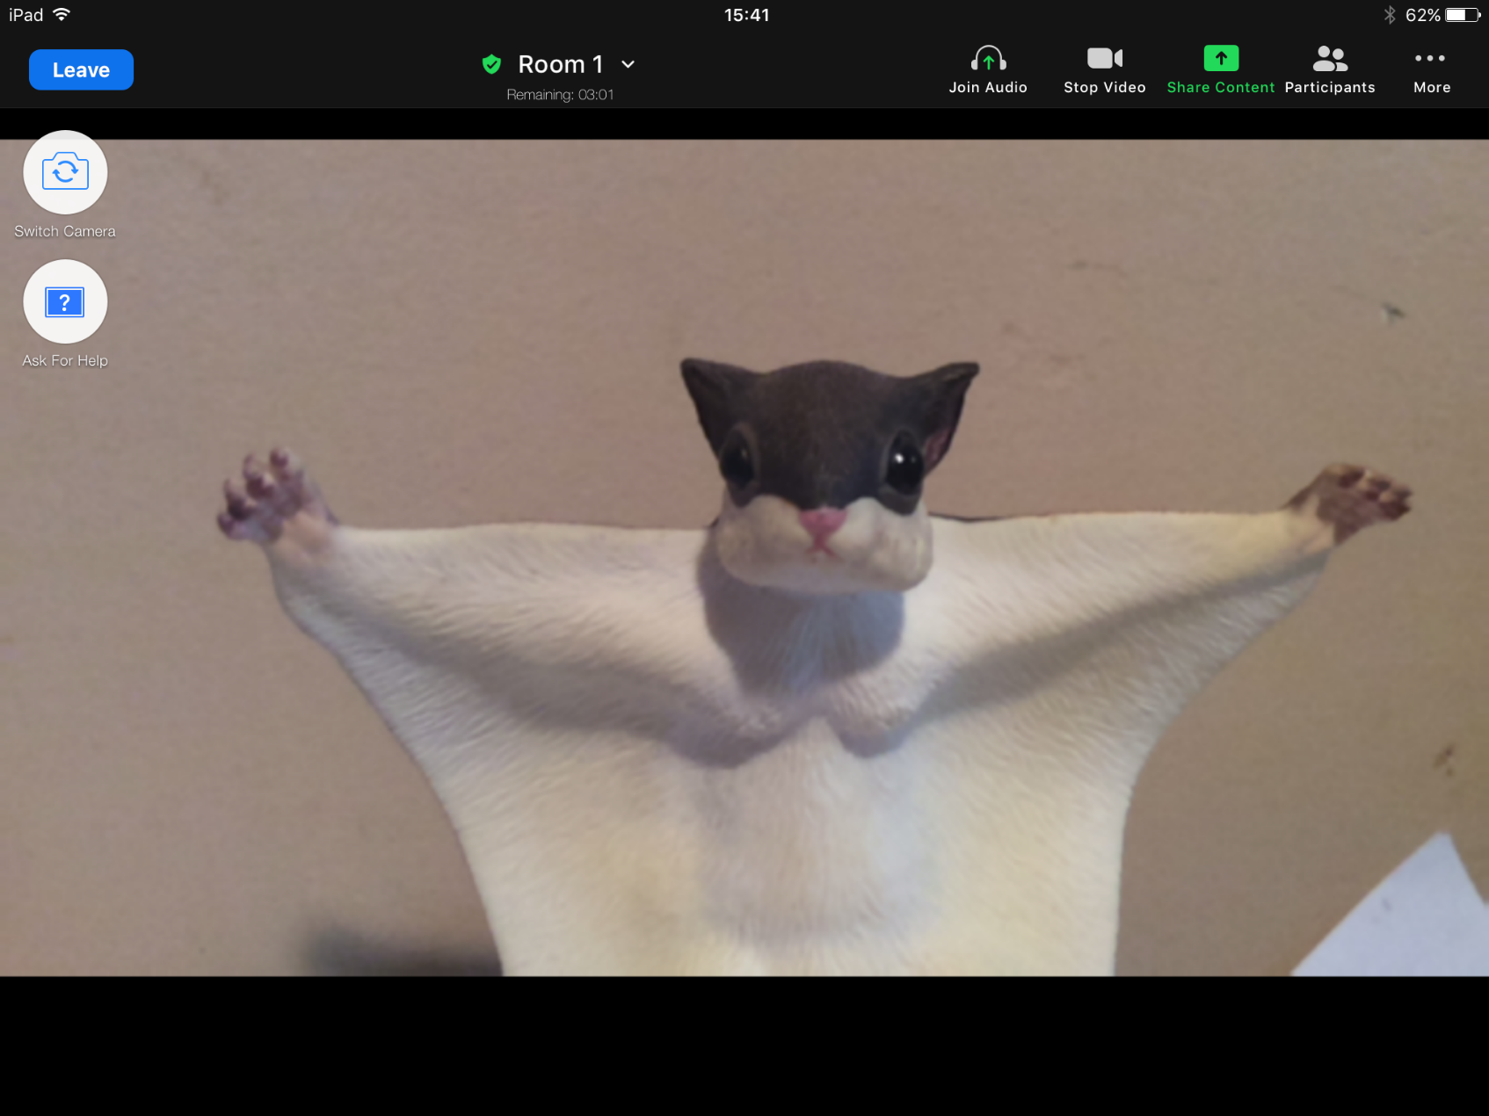
Sharing Video
Notes:
And keep in mind…

Slide 20
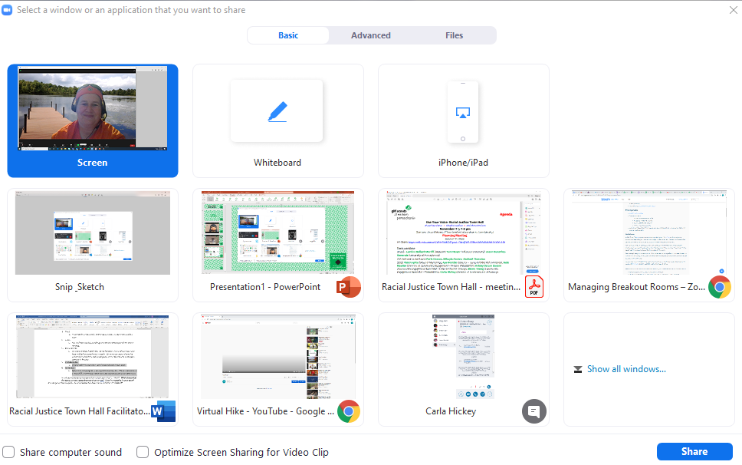
Sharing Video
Notes:
And keep in mind…

